Slide 1


Vikas Movva
2023-12-12

Slide 2

Outline
Executive Summary
Introduction
Methodology
Results
Conclusion
Appendix

Slide 3
Executive Summary
Summary of methodologies
In pursuit of identifying the determinants of a successful rocket landing, this research employs the following methodologies:
Data collection through SpaceX REST API and web scraping techniques.
Data wrangling to establish a success/fail outcome variable.
Data exploration utilizing visualization techniques, considering payload, launch site, flight number, and yearly trends.
Data analysis through SQL, encompassing calculations such as total payload, payload range for successful launches, and the overall count of successful and failed outcomes.
Investigation into launch site success rates and their proximity to geographical markers.
Visualization of launch sites showcasing the highest success rates and successful payload ranges.
Development of predictive models for landing outcomes, employing logistic regression, support vector machine (SVM), decision tree, and K-nearest neighbor (KNN).Summary of all results
Results
Exploratory Data Analysis:
Orbits ES-L1, GEO, HEO, and SSO have the highest success rates
The KSC LC-39A launch site has the highest success rate
The success rate of launches has gone up over time
Visualization
All launch sites are in the southern united states (closest to the equator) and close to the coast
Predictive Analytics
All machine learning models preformed similarly on the test data set however the decision tree model as a marginally better accuracy.

Slide 4
Introduction
Background
SpaceX stands out as the foremost successful entity in the commercial space era, revolutionizing space travel through cost-effectiveness. Highlighted on its website are Falcon 9 rocket launches, priced at 62 million dollars, in stark contrast to other providers whose costs soar above 165 million dollars per launch. The substantial savings stem from SpaceX's innovative practice of reusing the first stage. Consequently, forecasting the successful landing of the first stage becomes pivotal in determining the overall launch cost. Leveraging publicly available information and machine learning models, our objective is to predict whether SpaceX will opt to reuse the first stage.
Questions to be answered
How do variables such as payload mass, launch site, number of flights, and orbits affect the success of the first stage landing?
Does the rate of successful landings increase over the years?
What is the best algorithm that can be used for binary classification in this case?

Slide 5

Section 1

Slide 6
Methodology
Data collection methodology:
Data was collected from the SpaceX REST API and Wikipedia’s List of Falcon 9 Launches
Perform data wrangling
Data was filtered looking for missing values and categorical values which were then encoded using one hot encoding
Perform exploratory data analysis (EDA) using visualization and SQL
Data was visualized using the Seaborn library
Calculations on the data was made through SQL queries
Perform interactive visual analytics using Folium and Plotly Dash
Both an interactive map with launch sites and successful/failed launches and key statistical relationships were presented using Folium and Dash respectively
Perform predictive analysis using classification models
Using the dataset created through the previous steps various machine learning models were created using Grid-search algorithms to find the best hyperparameters for each model

Slide 7
Data Collection
Describe how data sets were collected.
Data was collected from the SpaceX REST API as well as Wikipedia’s List of Falcon 9 Launches webpage.
Data collected through the SpaceX REST API:
Flight number, date, Booster version, Payload mass, Orbit, Launch site, Outcome, Flight, Grid fins, Reused, Legs, Landing pad, Block, Reused count, Serial, Longitude, Latitude.
Data collected through web scraping Wikipedia:
Flight number, Launch site, Payload, Payload mass, Orbit, Customer, Launch outcome, Booster version, Booster landing, Date, Time

Slide 8
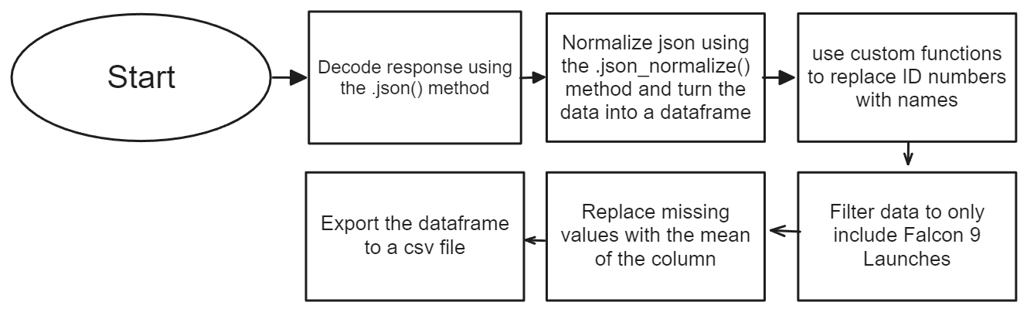
Data Collection – SpaceX API

Slide 9
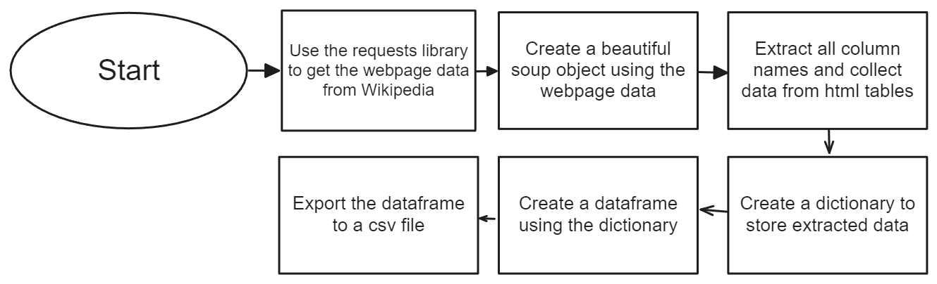
Data Collection - Scraping

Slide 10
Data Wrangling
Perform EDA and determine data labels
Calculate:
# of launches for each site
# and occurrence of orbit
# and occurrence of mission outcome per orbit type]
Create binary landing outcome column (dependent variable)
Export data to csv file
Landing Outcomes
Landing was not always successful
True Ocean: mission outcome had a successful landing to a specific region of the ocean
2023 Landing Outcome Cont.
False Ocean: represented an unsuccessful landing to a specific region of ocean
True RTLS: meant the mission had a successful landing on a ground pad
False RTLS: represented an unsuccessful landing on a ground pad
True ASDS: meant the mission outcome had a successful landing on a drone ship
False ASDS: represented an unsuccessful landing on drone ship
Outcomes converted into 1 for a successful landing and 0 for an
unsuccessful landing

Slide 11
EDA with Data Visualization
Charts:
Flight Number vs. Payload Mass, Flight Number vs. Launch Site, Payload Mass vs. Launch Site, Orbit Type vs. Success Rate, Flight Number vs. Orbit Type, Payload Mass vs Orbit Type and Success Rate Yearly Trend
These charts show the relationship between variables and if they exist could be used as a feature in a machine learning model

Slide 12
EDA with SQL
SQL queries preformed:
Displaying the names of the unique launch sites in the space mission
Displaying 5 records where launch sites begin with the string ‘CCA’
Displaying the total payload mass carried by boosters launched by NASA (CRS)
Displaying average payload mass carried by booster version F9 v1.1
Listing the date when the first successful landing outcome in ground pad was achieved Listing the names of the boosters which have success in drone ship and have payload mass greater than 4000 but less than 6000
Listing the total number of successful and failure mission outcomes
Listing the names of the booster versions which have carried the maximum payload mass
Listing the failed landing outcomes in drone ship, their booster versions and launch site names for the months in year 2015
Ranking the count of landing outcomes (such as Failure (drone ship) or Success (ground pad)) between the date
2010-06-04 and 2017-03-20 in descending order

Slide 13
Build an Interactive Map with Folium
Markers for launch site:
Added blue circles at JSC with a popup label showing the name and coordinates
Added red circles at all launch site coordinates with a popup label showing its name using its name using its coordinates
Colored Markers of Launch Outcomes
Added colored markers of successful and unsuccessful launches at each launch site
Added Distances between launch site to nearest coastline, railway, highway, and city

Slide 14
Build a Dashboard with Plotly Dash
Dashboard elements:
Dropdown list with launch sites
Pie chart showing successful launches
Slider of payload mass range
Scatter plot showing payload mass vs. Success rate by booster version

Slide 15
Predictive Analysis (Classification)
Created a NumPy array from the Class Column
Standardized the data with the StandardScalar object. Fitted and transformed the data
Split the data into a training set and a testing set using the train_test_split method
Created and used a GridSearchCV object on each machine learning algorithm for hyperparameter optimization
Calculated the accuracy of each model and created a confusion matrix
Identified the best model using different evaluators like theJaccard score, F1 score, Accuracy, etc.

Slide 16
Results
Exploratory Data Analysis
Launch success has improved over time
KSC LC-39A has the highest success rate among landing sites
Orbits ES-L1, GEO, HEO and SSO have a 100% success rate
Visual Analytics
Most launch sites are near the equator, and all are close to the coast
Launch sites are far enough away from anything a failed launch can damage (city, highway, railway), while still close enough to bring people and material to support launch activities
Predictive Analytics
Decision Tree model is the best predictive model for the dataset

Slide 17

Section 2

Slide 18
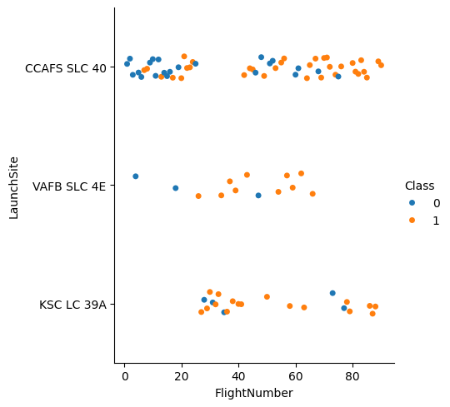
Flight Number vs. Launch Site
Success rate increases as the flight number increases
Majority of launches were from the CCAFS SLC 40 launch site
The other two launch sites have a higher success rate
The data shows that flight number and success rate has a positive relationship

Slide 19
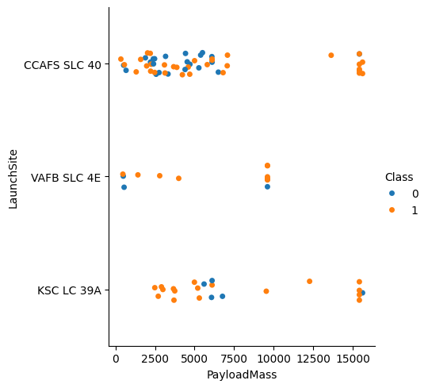
Payload vs. Launch Site
The data shows that the higher the payload mass the higher the success rate.
A payload above 12500 at the CCAFS SLC 40 launch site has a 100% success rate
Payload greater than 10000 was never launched at the VAFB SLC 4E launch site

Slide 20
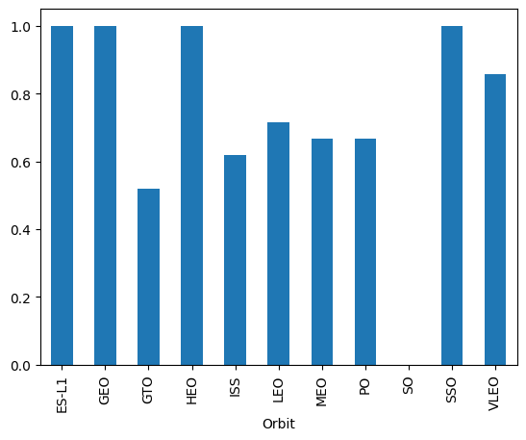
Success Rate vs. Orbit Type
ES-L1, GEO, HEO, and SSO have a 100% success rate
GTO, ISS, LEO, MEO, and PO have a success rate that is between 50% - 80%
SO has a 0% success rate

Slide 21
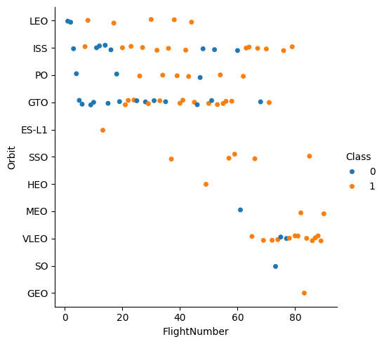
Flight Number vs. Orbit Type
The success rate increases as the flight number increases
An exception is GTO where this trend is not evident

Slide 22
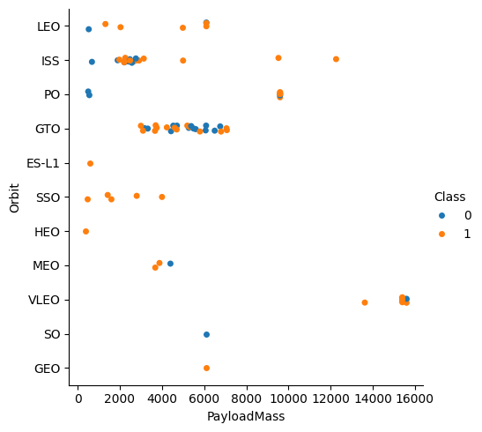
Payload vs. Orbit Type
Higher payloads show greater success for LEO, ISS, and PO orbits
GTO success is mixed at all displayed payloads

Slide 23
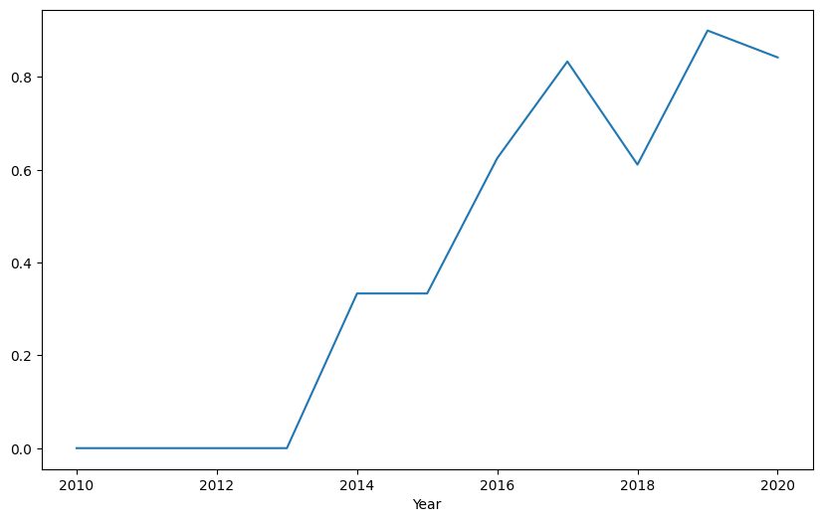
Launch Success Yearly Trend
Overall the success rate improves over time
The only time the success rate went down was during 2017 – 2018 and 2019 to 2020

Slide 24
All Launch Site Names
Find the names of the unique launch sites
Present your query result with a short explanation here

Slide 25
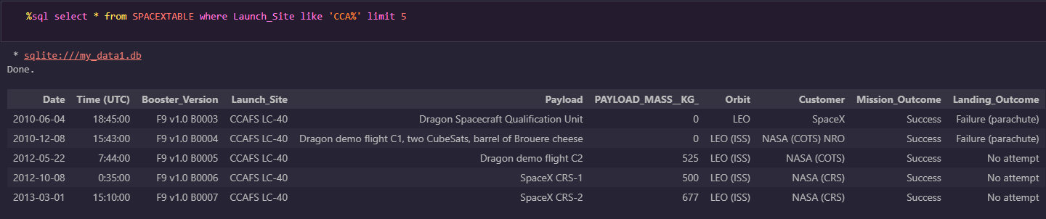
Launch Site Names Begin with 'CCA'
Launch sites:
CCAFS LC-40
CCAFS SLC-40
KSC LC-39A
VAFB SLC-4E

Slide 26
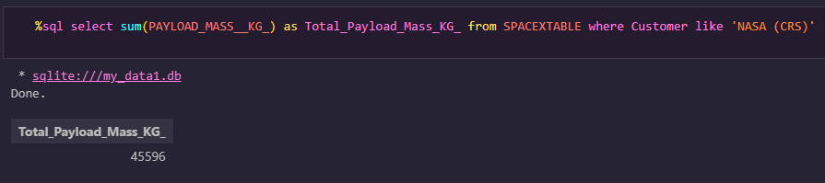
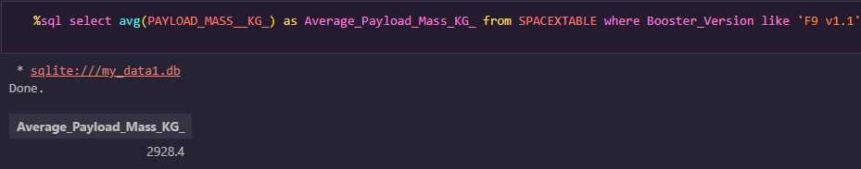
Payload Mass
Total payload mass
Average payload mass

Slide 27
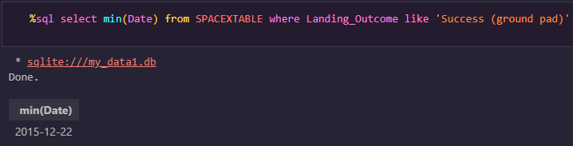
First Successful Ground Landing Date

Slide 28
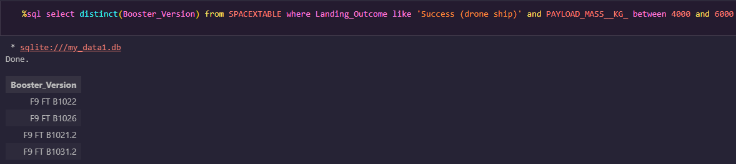
Successful Drone Ship Landing with Payload between 4000 and 6000

Slide 29
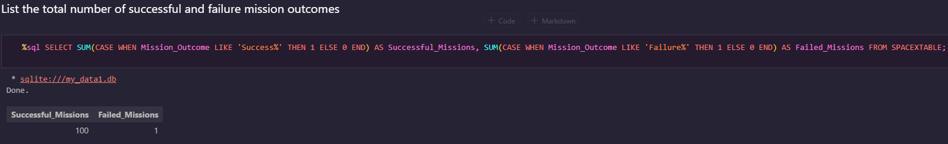
Total Number of Successful and Failure Mission Outcomes

Slide 30
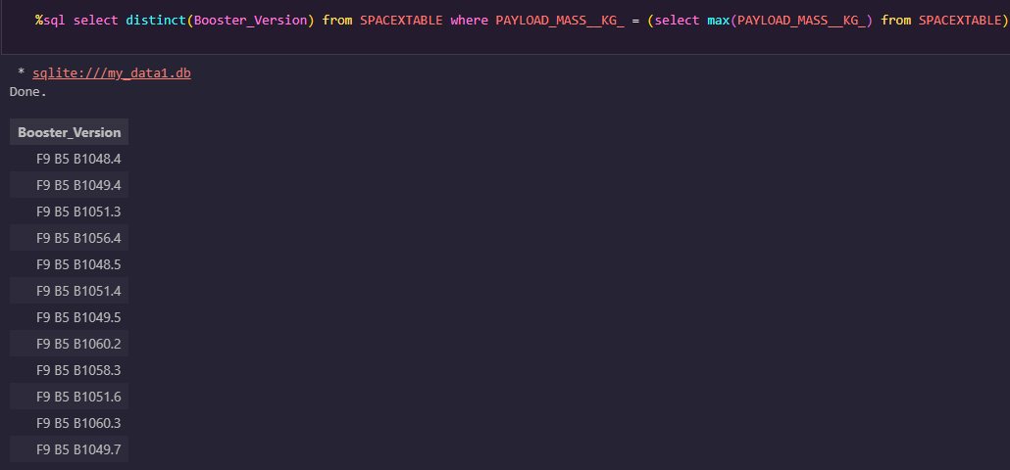
Boosters Carried Maximum Payload

Slide 31
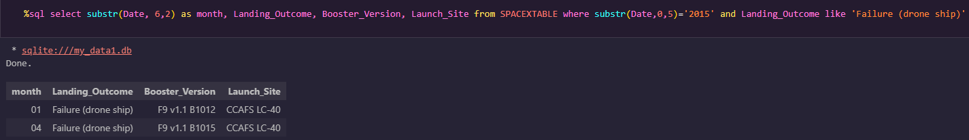
2015 Launch Records

Slide 32
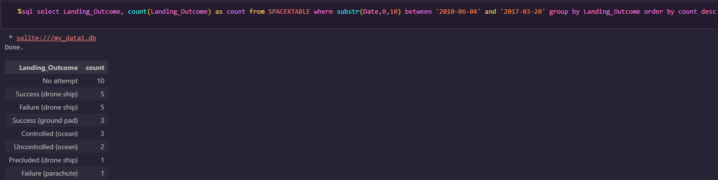
Rank Landing Outcomes Between 2010-06-04 and 2017-03-20

Slide 33

Section 3

Slide 34
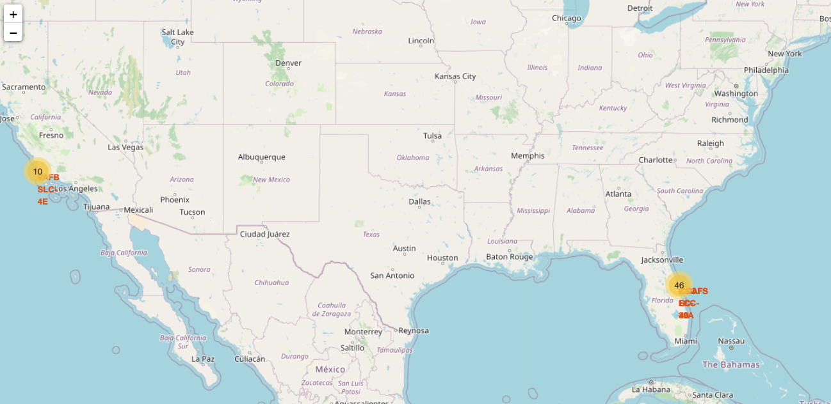
Launch Sites
All launch sites are in the southern US in order to be close to the equator. This is because the rockets use the angular momentum of the earth’s rotation to help with the launch. This saves the cost of loading additional fuel into the boosters

Slide 35

Launch Outcomes
Launch outcome markers:
Green – Successful launches
Red – Failed launches

Slide 36
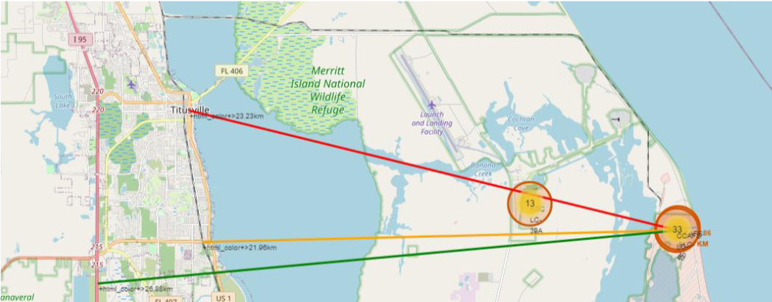
Distance to points of interest
Distance from nearest coastline: 0.86km
Distance from nearest railway: 21.96km
Distance from nearest city: 23.33km
Distance from nearest highway:26.88km

Slide 37

Section 4

Slide 38
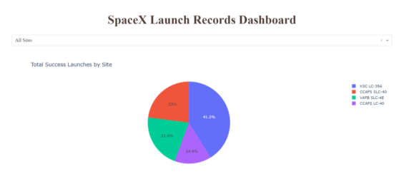
Launch Success by Site
KSC LC-39A has the greatest number of successful launches

Slide 39
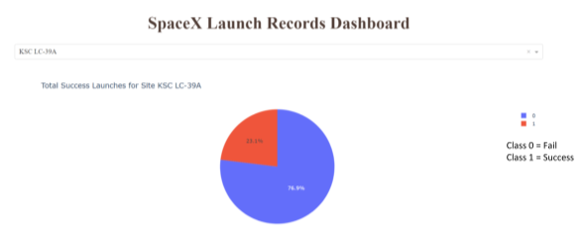
Launch Success of Launch site KSC LC-29A
KSC LC-29A has a launch success rate of 76.9%

Slide 40
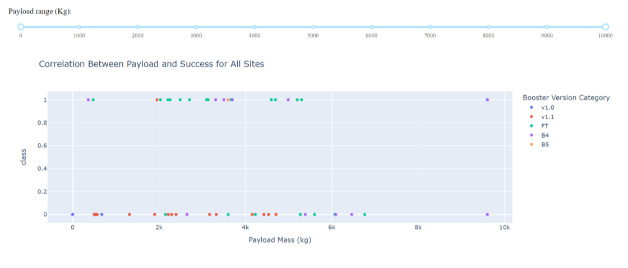
Payload Mass in Relation to Launch Success
Payloads between 2000kg and 5000kg have the highest success rate

Slide 41

Section 5

Slide 42
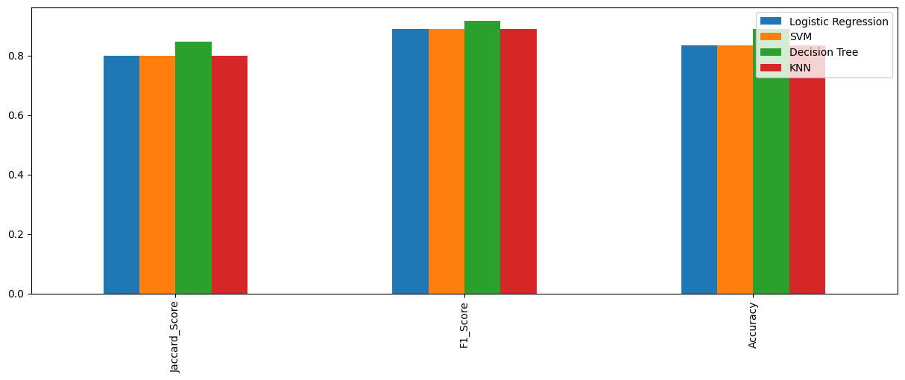
Classification Accuracy
The accuracy scores are similar for all models however the decision tree model seems to have a marginally higher score

Slide 43

Confusion Matrix
The confusion matrix of the decision tree model is like all the other models even though it is the best performing one.
Confusion matrix outputs:
TP: 12
TN: 3
FP: 3
FN: 0

Slide 44
Conclusions
Model Performance: The models performed similarly on the test set with the decision tree model slightly outperforming
Equator: Most of the launch sites are near the equator for an additional natural boost - due to the rotational speed of earth - which helps save the cost of putting in extra fuel and boosters
Coast: All the launch sites are close to the coast • Launch Success: Increases over time
KSC LC-39A: Has the highest success rate among launch sites. Has a 100% success rate for launches less than 5,500 kg
Orbits: ES-L1, GEO, HEO, and SSO have a 100% success rate
Payload Mass: Across all launch sites, the higher the payload mass (kg), the
higher the success rate

Slide 45


